Slide 1
Asynchronous programming in Javascript

Slide 2
Overview
Javascript overview
Introduction about synchronous programming
Introduction about asynchronous programming
Introduction about Web APIs
Introduction about Promise
Introduction about Async/Await
Introduction about Web workers
Summary
Q&A

Slide 3
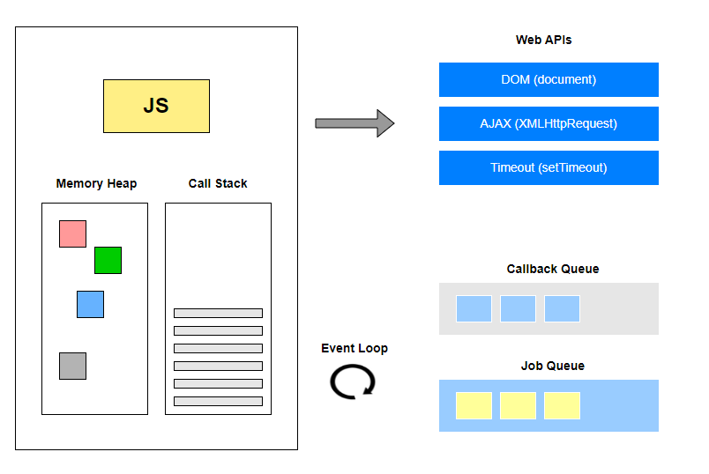
Javascript Overview

Slide 4
Javascript Overview
Javascript is a single-threaded, non-blocking, asynchronous and concurrent language consisting of a Memory Heap, a Call Stack, an Event Loop, a Callback Queue, a Job Queue and WebAPIs with HTTP requests, timers, events, etc…
Javascript is an interpreted programming language.
Javascript Engine includes 2 main components: Call Stack and Memory Heap.
Javascript Runtime includes components such as Browser APIs/Web APIs, Event Loop, Callback Queue, Job Queue, Javascript Engine.

Slide 5
Synchronous Programming
Begin
Task 1
Task 2
…..
Task n
End

Slide 6
Synchronous Programming
Advantages of synchronous programming: Code is clear, easy to read, easy to debug.
Disadvantage of synchronous programming: Synchronous means blocking, the program will be blocked on time-consuming high-volume statements or executing a task with a timeout. Suppose we want to fetch a large amount of data from the database and then display it to the user interface. When the program runs to this segment, it will have to wait for the data download to complete and then display it on the interface, it will bring a bad experience to the user.

Slide 7
Synchronous Programming - How does Call Stack Work?
Calling Methods Sequentially

Slide 8
Synchronous Programming - How does Call Stack Work?
Calling Nested Methods

Slide 9
Synchronous Programming - How does Call Stack work?
When calling a function, the Javascript engine adds it to the Call Stack and executes it.
If the current executable calls another function, the Javascript engine adds that function to the Call Stack and starts executing it.
When the 2nd function is done executing, Javascript engine will throw it out of Call Stack.
Javascript engine continues to execute the first function at the time it leaves the function.
When the 1st function finishes executing, Javascript engine will throw the 1st function out of the Call Stack.
Continue in this way until there is nothing left in the Call Stack.
Call Stack - is a data structure in the form of a stack (stack) used to store information about the operation of a computer program during execution, specifically recording our position in the program. If we call a function, we put it at the top of the stack. If we return from a function, we throw that function off the top of the stack. That's all the stack can do.

Slide 10
Asynchronous Programming
Asynchronous programming is a technique that enables your program to start a potentially long-running task and still be able to be responsive to other events while that task runs, rather than having to wait until that task has finished.
We can classify most of the asynchronous programming in Javascript into 2 main categories.
Browser APIs/Web APIs: include methods such as setTimeout, event handlers such as mouse click, mouse move, fetch() ….
Promises: a single object in Javascript that allows asynchronous operations

Slide 11
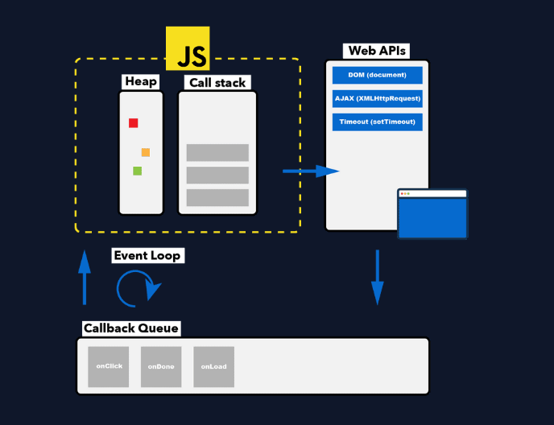
Asynchronous Programming - Browser APIs/Web APIs

Slide 12
Lập trình bất đồng bộ - Browser APIs/Web APIs

Slide 13
Lập trình bất đồng bộ - Browser APIs/WEB APIs
Let's see the example above and consider the working mechanism of Browser APIs / Web APIs as follows:
There are two new components in the above example: Web APIs and Callback Queue. When the JS engine pushes the commands to the Call Stack. In case the execution command is an event or function of the Web APIs, it will be executed asynchronously, after the execution is complete, callback function declared in the method is pushed to the Callback Queue and called Macro Tasks. Event Loop will runs continuously to keep track of Callback Queue, When all Call Stack tasks are completed, meaning Call Stack is empty, Event Loop will push Macro Task from Callback Queue to Call Stacks. Then the program continues to execute the Task Queue in the Call Stack like normal functions.

Slide 14
Asynchronous Programming - Promise
Promises are another way to handle asynchronous operations instead of using callbacks.
Promise has 3 states are pending, fulfilled, rejected
Create a Promise with the Promises constructor, passing an argument called an executor function containing 2 arguments, the first argument is a callback function to execute when the Promise is resolve, the second argument is a callback function to execute when the Promise is rejected. Executor functions work asynchronously. After a Promise is executed, you can process the result using the .then() method and catch any errors with the .catch() method.
new Promise( (resolve, reject) => { asynchronous operation } )
new Promise( (resolve) => { asynchronous operation } ) // reject is null
new Promise( (null, reject) => { asynchronous operation } ) // resolve is null
Promises are often used to fetch data.
JS does not use Callback Queue to push the callback function when the asynchronous operation completes or fails, but instead uses another queue called Job Queue which has higher priority than Callback Queue.
How to use Promise

Slide 15
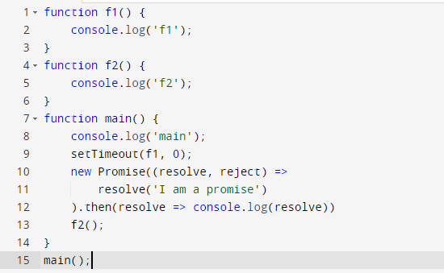
Asynchronous Programming - Promise Demo

Slide 16
Asynchronous Programming - How does Job Queue work?
When the running program encounters a statement that initiates a Promise, the executor function executes asynchronous immediately, the Promise's asynchronous operation is processed, one of the executor's two callback functions is called, and the Promise's state is updated accordingly. When the Promise state is updated successfully, trigger the .then() method, which wraps the handler code in the then() method, and pushes it to the Job Queue creating a Micro Task.
The Event Loop prioritizes scanning through the Job Queue first, if there is a Micro task in the Job Queue and the Call Stack is empty, the Event Loop will push the task from the Job Queue to the Call Stack.
Micro Tasks will execute in the Callback Stack like regular functions.
Event Loop keeps scanning through the Job Queue, If the Job Queue is empty then the Event Loop will scan through the Callback Queue, If there is a Macro Task in the Callback Queue and the Call Stack is empty, this Macro Task will be pushed through the Call Stack and executed.

Slide 17
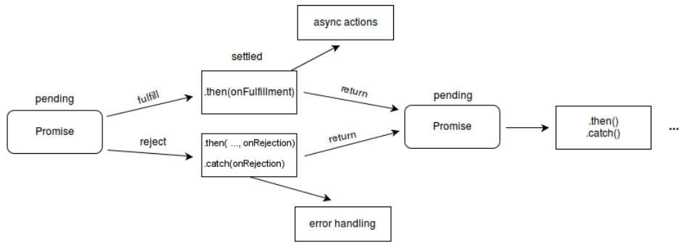
Asynchronous Programming - Promises Life Cycle

Slide 18
Asynchronous Programming - Promise Methods
Promise.all()
Promise.allSettled()
Promise.any()
Promise.prototype.catch()
Promise.race()
Promise.reject()
Promise.resolve()
Promise.prototype.then()
Promise methods

Slide 19
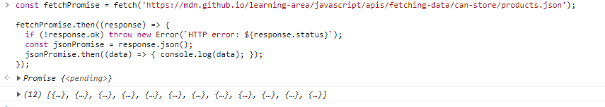
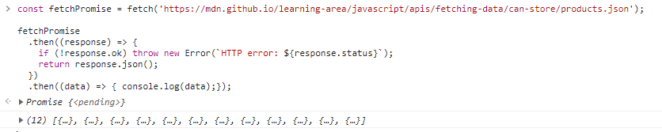
Asynchronous Programming - Promise Demo
Chaining promises:

Slide 20
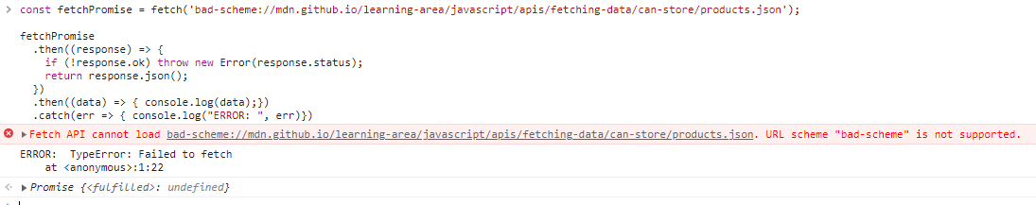
Asynchronous Programming - Promise Demo
Catching errors promises:

Slide 21
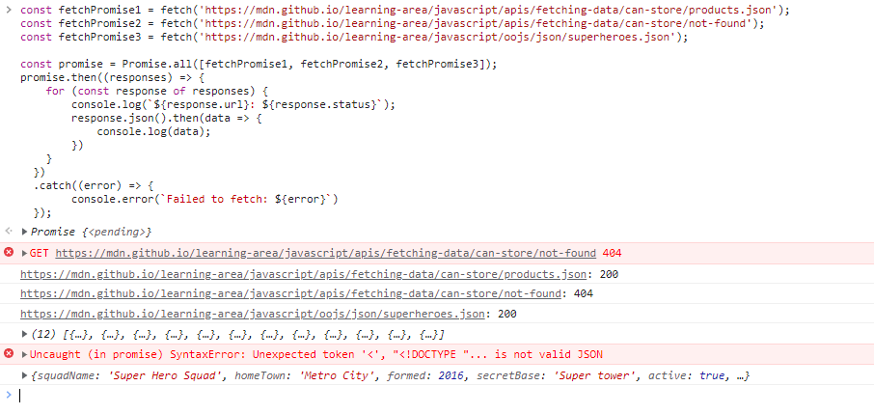
Asynchronous Programming - Promise Demo
Promise.all():

Slide 22
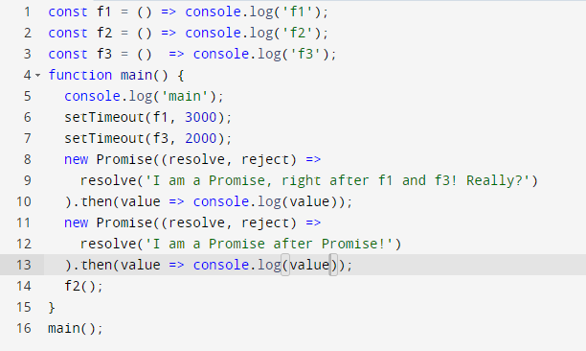
Asynchronous Programming - Promise Summary Demo

Slide 23
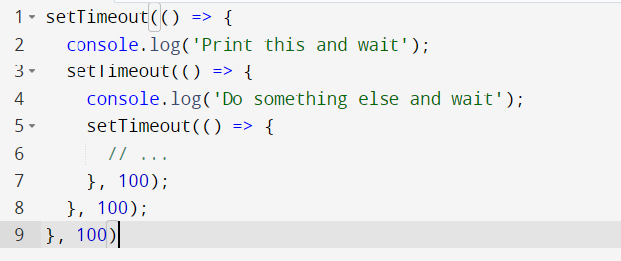
Asynchronous Programming - Why we need Promise while we already have callbacks?
Callback hell:

Slide 24
Asynchronous Programming - Async/Await
Here is the syntax to work with Promises more easily. This enables you to write code that uses asynchronous functions but looks like synchronous code.
A function declared with the async keyword will always return a Promise.
The await keyword is only used in an async function, an async function can have one or more await expressions.
When the await expression is called, the program will block the execution thread right at the place of the await expression and wait until the Promise returns the result has been processed or returns an error, so the code snippets below the expression await in an async function will not be executed until the Promise returns the result. However, the outer thread will not be blocked, because await only calls in async method, and async function is a function that returns a Promise, so when calling async method, that method will work asynchronously, so the program will not be blocked.
The error of an await expression can be caught with a regular try/catch.
An async function without an await expression will run synchronously.

Slide 25
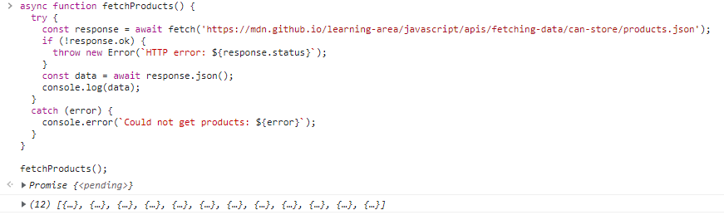
Asynchronous Programming - Async/Await Demo

Slide 26
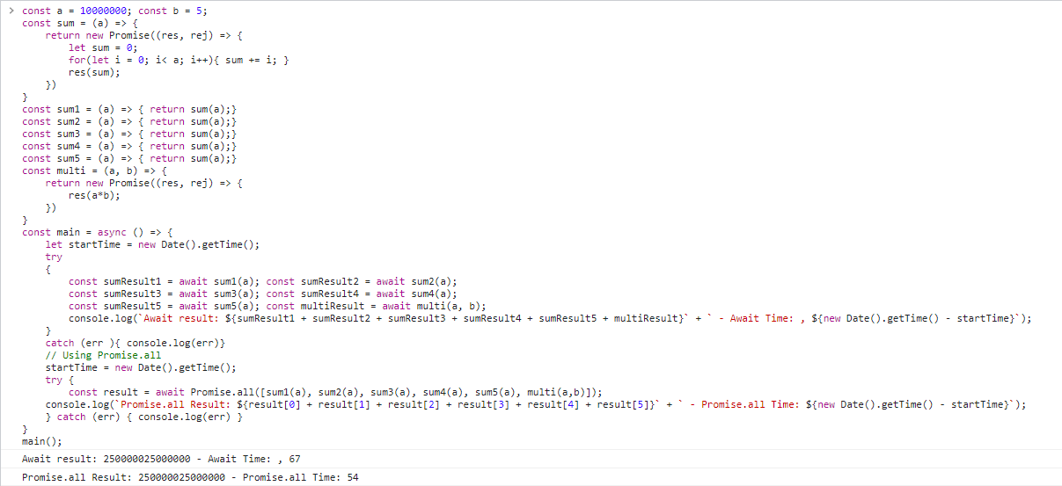
Asynchronous Programming - Async/Await vs Promise Demo

Slide 27
Asynchronous Programming - Workers
Usually, large computational tasks will be assigned to the server to handle. However, If you are forced to process a large amount of computation on the Client, how do you avoid the problem of freezing the browser because Javascript is a single-threaded programming language. Web Workers will help you solve that problem
Web workers give you the ability to run some tasks in a different thread.
There are 3 workers:
Dedicated workers
Shared workers
Service workers
Using Worker constructor to create a worker
Web workers

Slide 28
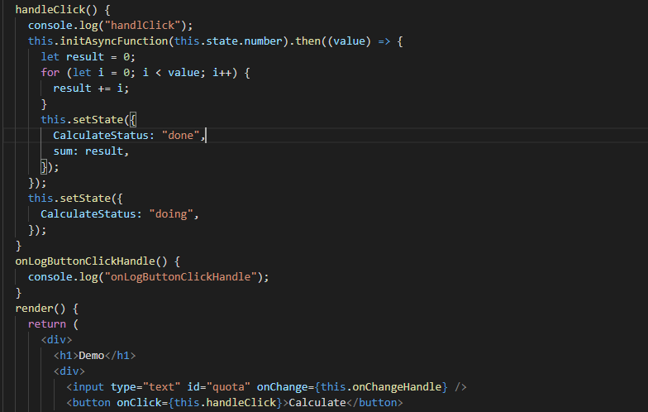
Asynchronous Programming - Workers demo
Browser freezing problem:
Web workers

Slide 29
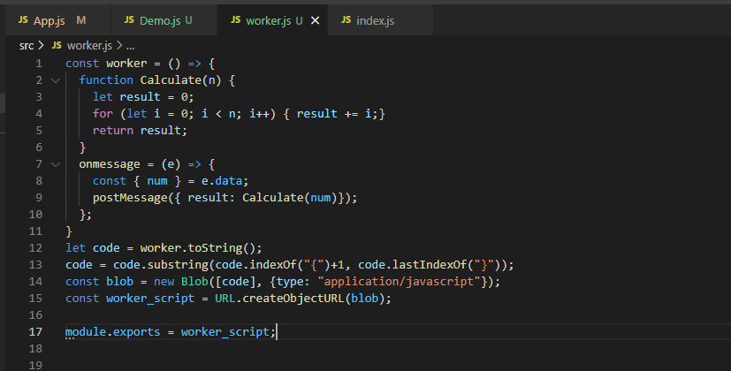
Asynchronous Programming - Workers demo
Resolution: add worker.js file

Slide 30
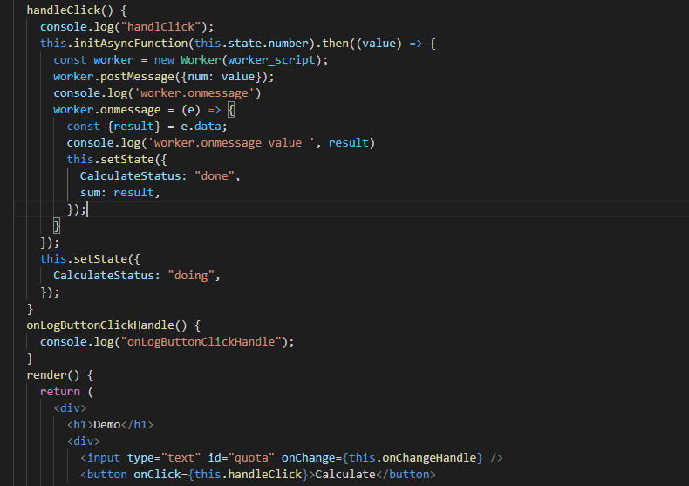
Asynchronous Programming - Workers demo
Resolution: using worker to send message and receive message

Slide 31
Summary
The Javascript engine uses the Call Stack to keep track of the functions being executed.
Call Stack executes functions sequentially.
Web APIs use callback functions to execute tasks when the asynchronous/delay operation completes. These callback functions are pushed to the Callback Queue.
Promises make it easier to handle asynchronous tasks and solve the Callback Hell problem.
The Promise's predefined scripting functions in the .then() function after the Promise has been processed will be pushed into the Job Queue.
The Job Queue has a higher priority than the Callback Queue in the Event Loop.
Async/Await offers a simpler, cleaner, easier to understand and more synchronous style of dealing with asynchronous operations with the core still coming from Promises.
Functions declared with the default async keyword return a Promise.
The await keyword is only executed in the async function, the program will block the lines after the await command in the async function, the outside thread is not blocked.
Async/await can be combined with Promises to make asynchronous handling even easier.
Promise.all() is faster than multi await with multiple tasks that do not depend on each other.
Web worker give us the ability to run some tasks in a different thread

Slide 32
Q & A

Slide 33
Thank you

Slide 34
Thank you

